Slide 1
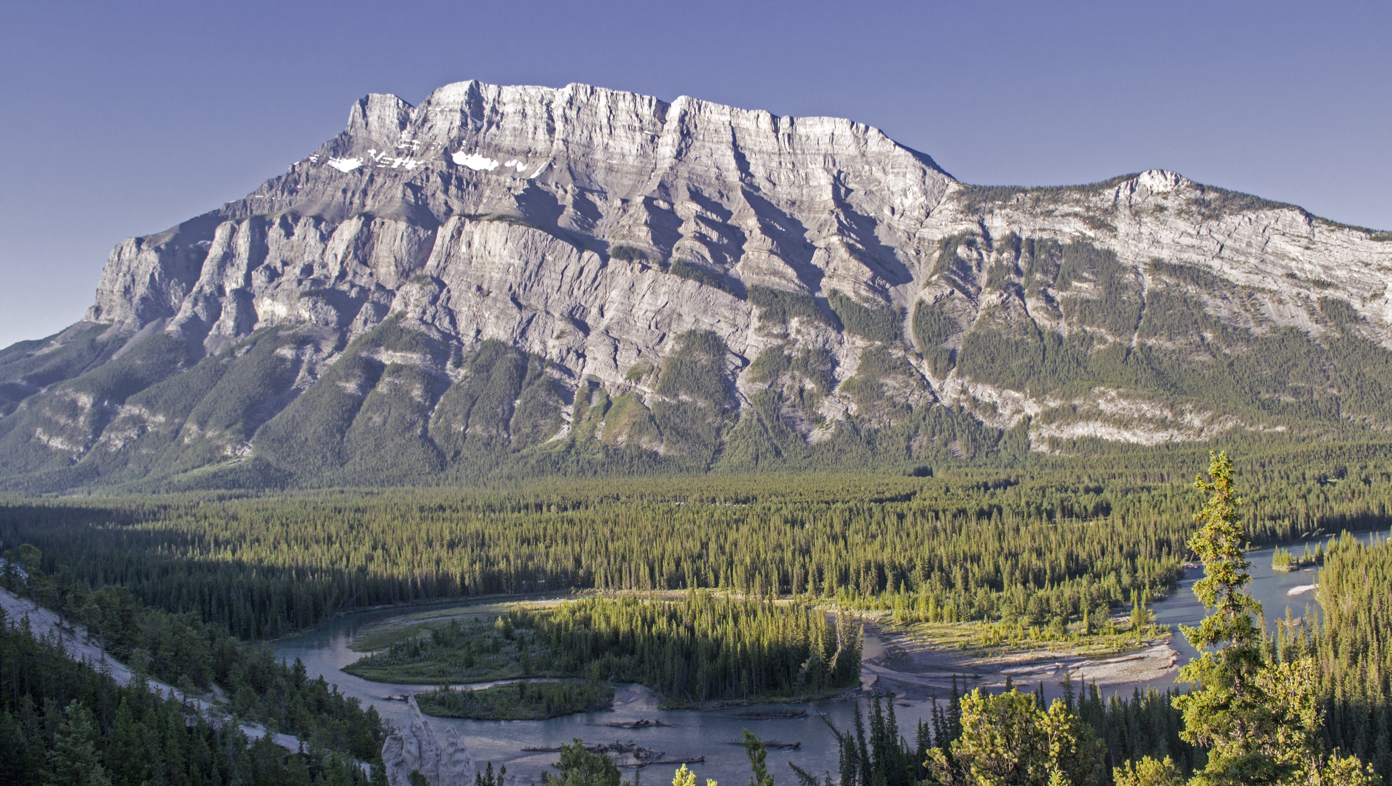
WEATHER DISEASE
To discuss the issue of global climate and disease

Slide 2
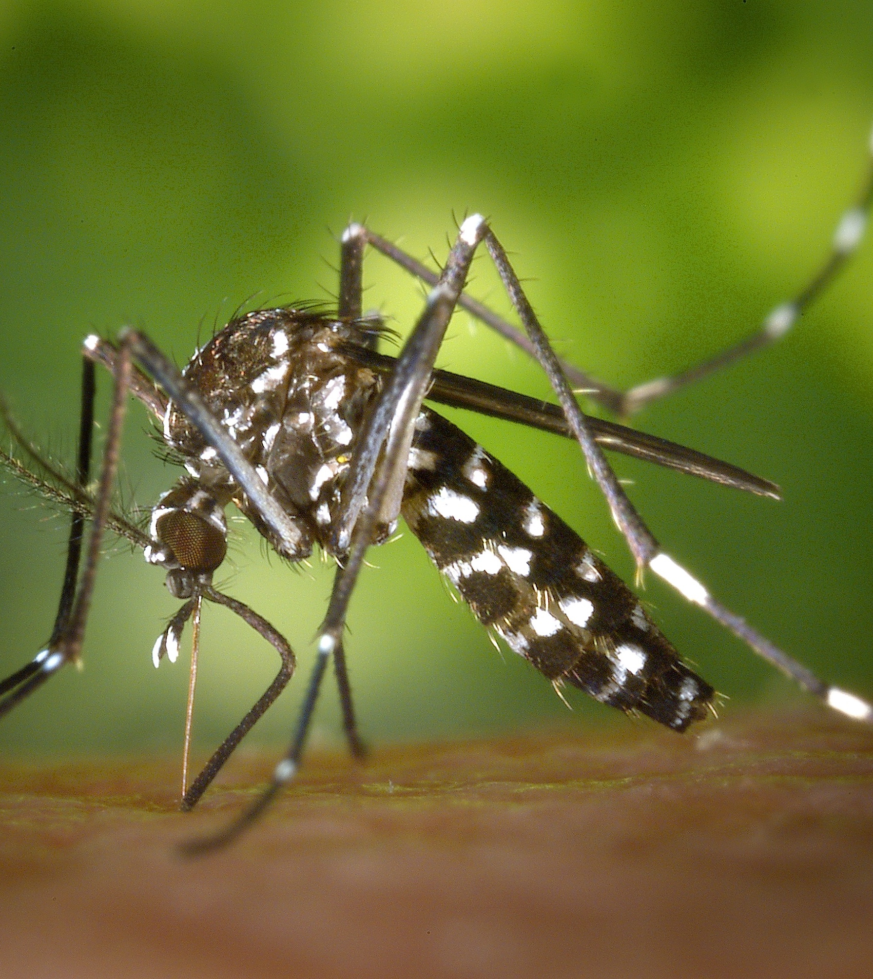

DENGUE
WEATHER
DATASET
DATASET
Area,Age,Gender Statistics - Gengus
Taiwan CDC News
WHO Disease Outbreak News
Yahoo Weather API
Year observation data – CMB

Slide 3
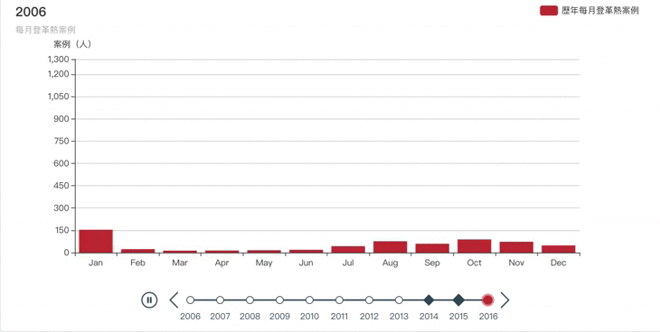
STATISTICS OF DENGUE CASES IN TAIWAN

Slide 4
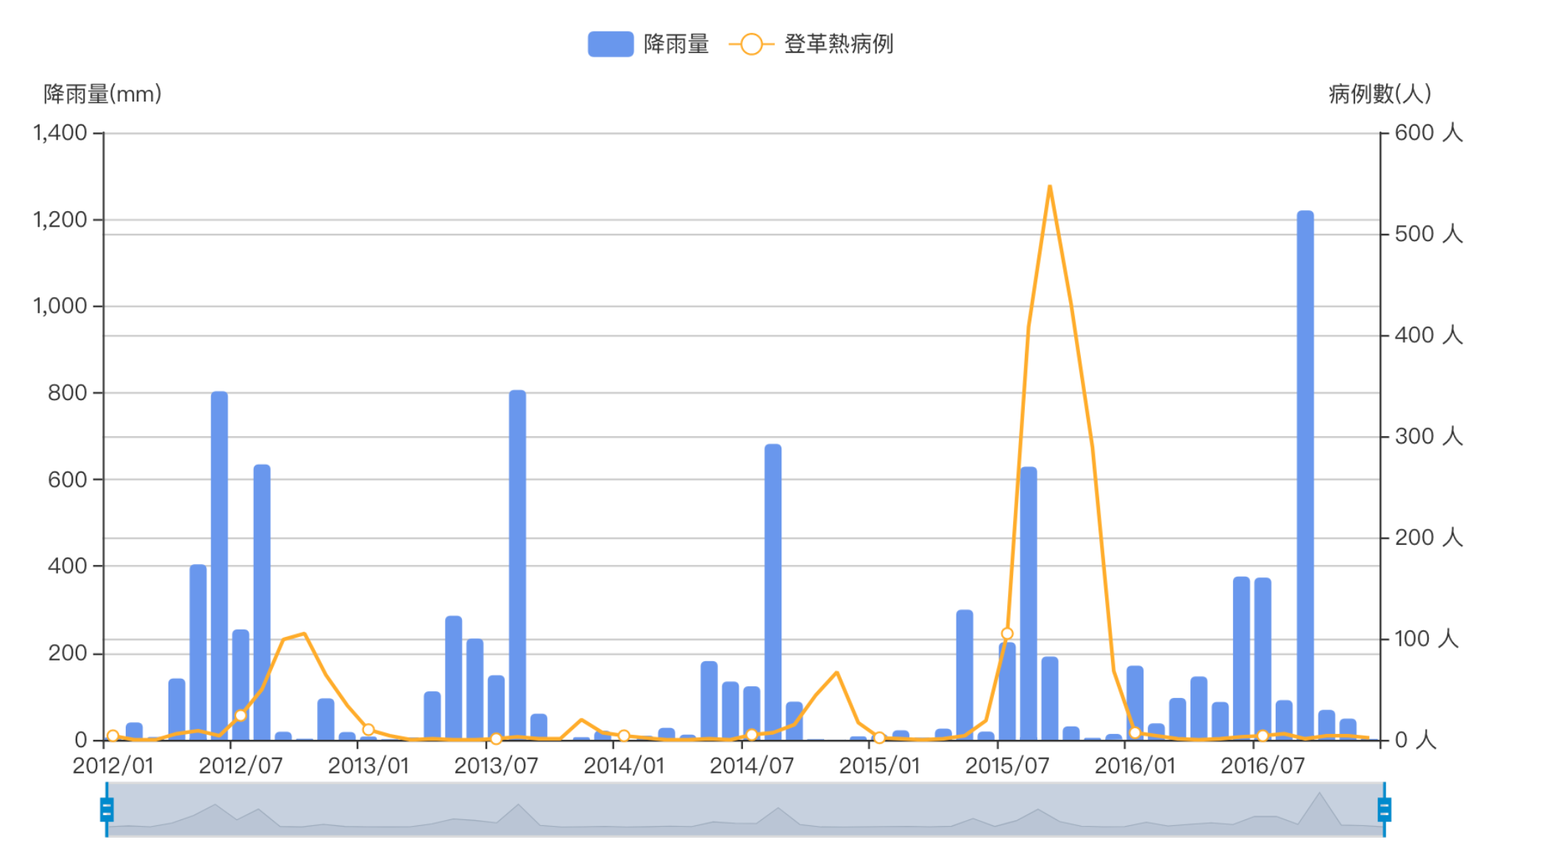
COMPARISON CHART OF
DENGUE CASES AND RAINFALL IN TAINAN

Slide 5
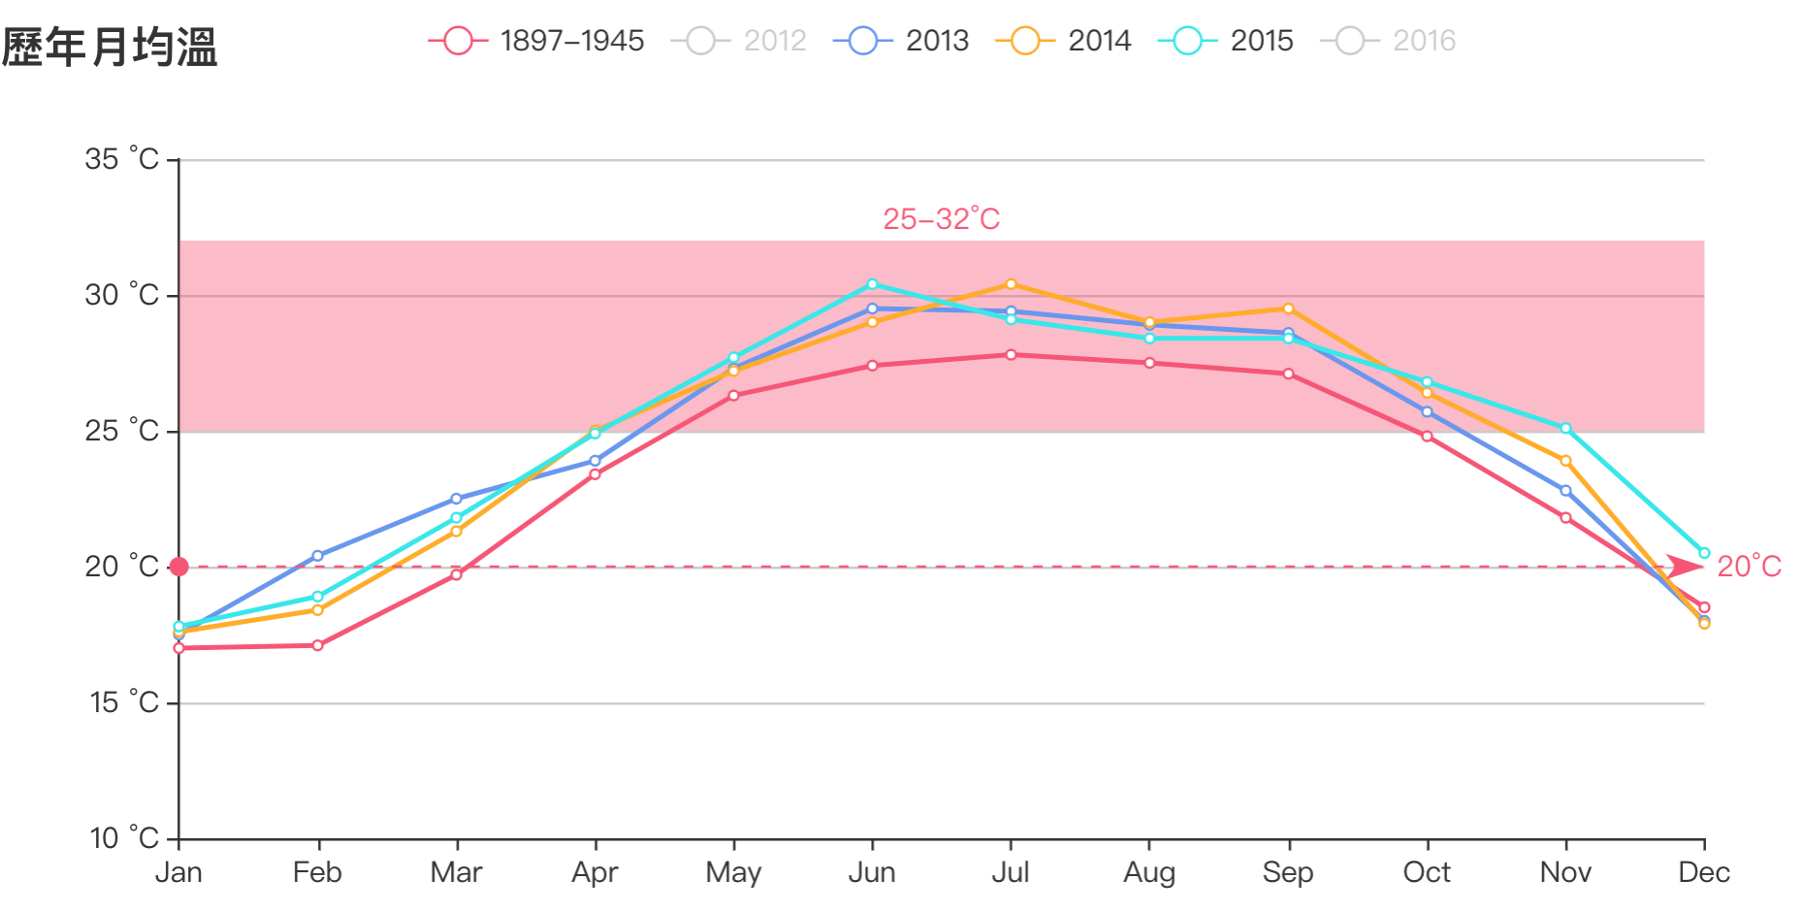
COMPARE CHAERT
OF MOUTHLY TEMPERATURE IN TAINAN
The most likely to spread the dengue virus temperature is
25~ 32 ° C

Slide 6
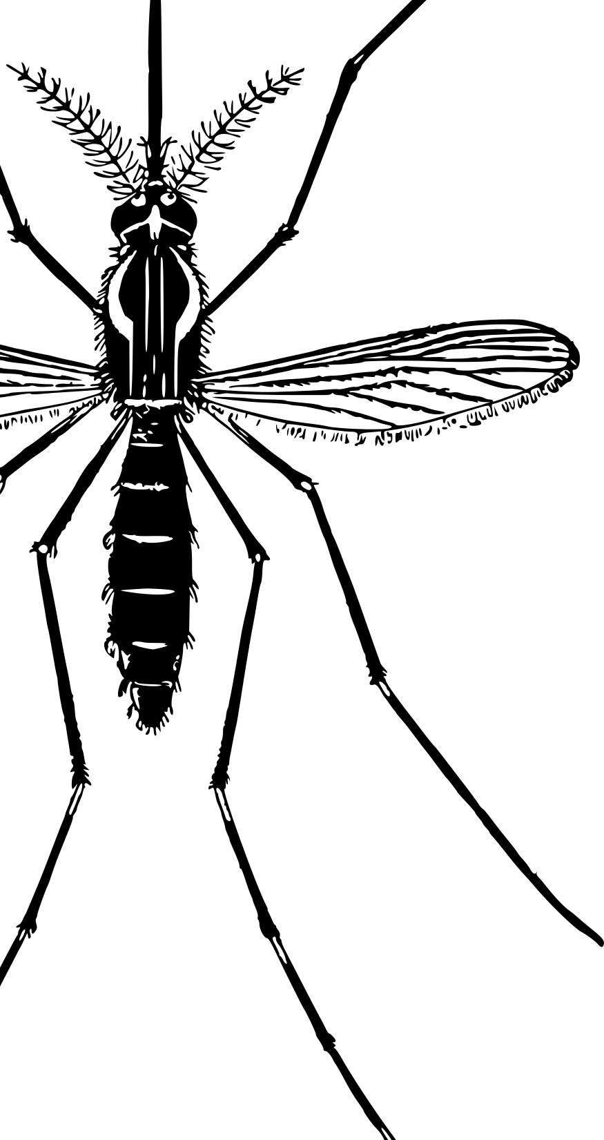
CONCLUSION
Dengue cases increase yearly
When raining heaving , dengue cases will increase
Temparture increase yearly and when temparture fall in the area between 25°c to 32°c , mosquitoes are easy to reproduce

Slide 7
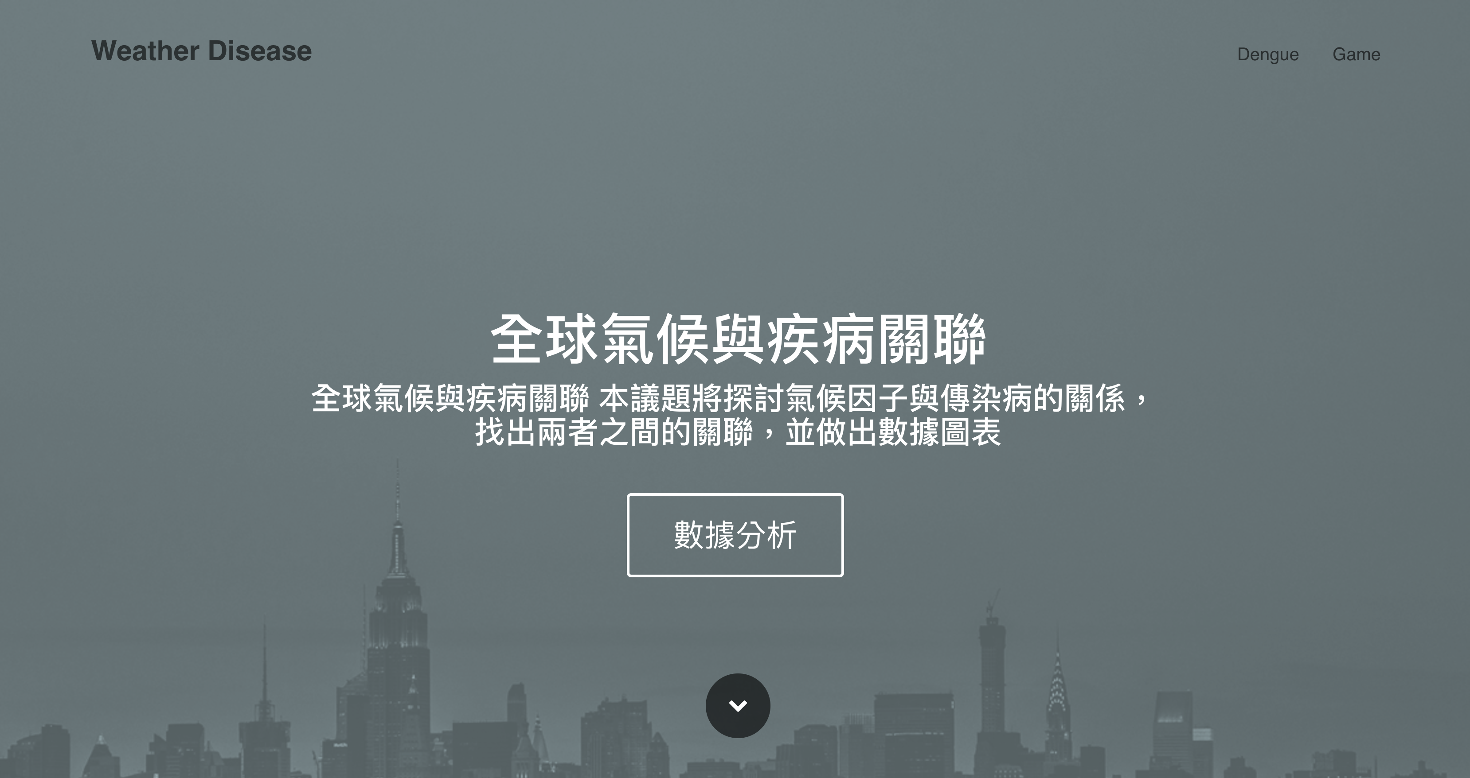
Weather Disease WebSite
URL : http://4xtw.tk

Slide 8


Dengue Helper
Global real-time weather
Real-time disease news.
Global map
Taiwan dengue
Dengun fever prevention

Slide 9

THANK YOU

